Slide 2
Diving into Mastery Guidance for Educators
Each activity sheet is split into three sections, diving, deeper and deepest, which are represented by the following icons:
These carefully designed activities take your children through a learning journey, initially ensuring they are fluent with the key concept being taught; then applying this to a range of reasoning and problem-solving activities.
These sheets might not necessarily be used in a linear way. Some children might begin at the ‘Deeper’ section and in fact, others may ‘dive straight in’ to the ‘Deepest’ section if they have already mastered the skill and are applying this to show their depth of understanding.
Diving
Deeper
Deepest

Slide 3
Aim
Plot specified points and draw sides to complete a given polygon.

Slide 4
Draw on a Grid
Diving
Can you plot the two coordinates on the grid?
6
(1,6), (4,6)
5
These coordinates are two vertices of a square. Can you plot two more points to make the square?
4
3
What are the coordinates of the two new points you have plotted?
2
1
(1,3), (4,3)
0
0
1
2
3
4
5
6

Slide 5
Draw on a Grid
Diving
Can you plot the two coordinates on the grid?
6
(5,1), (2,3)
5
These coordinates are two vertices of a trapezium. Can you plot two more points to make the trapezium?
4
3
What are the coordinates of the two new points you have plotted?
2
1
There are many different answers.
Here’s one: (1,1) (5,3)
0
0
1
2
3
4
5
6

Slide 6
Draw on a Grid
Diving
Can you plot the two coordinates on the grid?
6
(5,1), (2,3)
5
These coordinates are two vertices of a trapezium. Can you plot two more points to make the trapezium?
4
3
What are the coordinates of the two new points you have plotted?
2
1
Another correct answer is: (5,5) (2,5)
0
0
1
2
3
4
5
6

Slide 7
Draw on a Grid
Deeper
If I plot three points on a grid, I will always make a triangle.
Is Isaac correct? Can you plot three points in different ways on the grids below to prove your explanation?
6
6
5
5
These three points are all in a straight line so they don’t make a triangle.
4
4
3
3
These three points make a triangle.
2
2
1
1
0
0
0
1
2
3
4
5
6
0
1
2
3
4
5
6

Slide 8
Draw on a Grid
Deepest
The coordinate point shown on this grid is a shared vertex of two different types of pentagons. Can you plot the missing vertices and draw lines to construct the two different types of pentagons? Give the coordinates of each vertex of each pentagon.
12
There are many different answers.
Here’s one:
11
10
(6,9)
(9,9)
9
8
(4,8)
7
(11,7)
6
(4,6)
5
6,5)
4
(11,4)
3
(7,4)
2
1
0
0
1
2
3
4
5
6
7
8
9
10
11
12

Slide 9
Draw on a Grid
Deepest
The coordinate point shown on this grid is a shared vertex of a trapezium and a parallelogram. Can you plot the missing vertices and draw lines to construct the two different quadrilaterals? Give the coordinates of each vertex of each quadrilateral.
12
(2,11)
(5,11)
There are many different answers.
Here’s one:
11
10
9
8
7
(11,6)
6
5
(1,6)
4
3
2
1
(5,2)
(10,2)
0
0
1
2
3
4
5
6
7
8
9
10
11
12

Slide 10
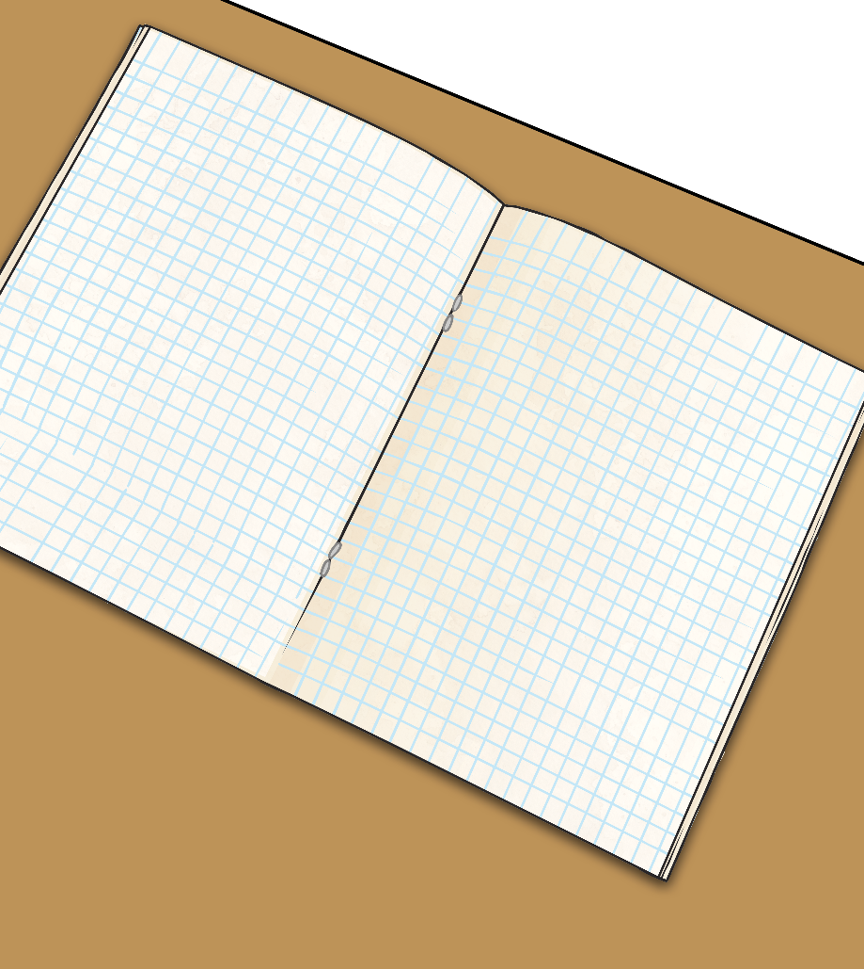
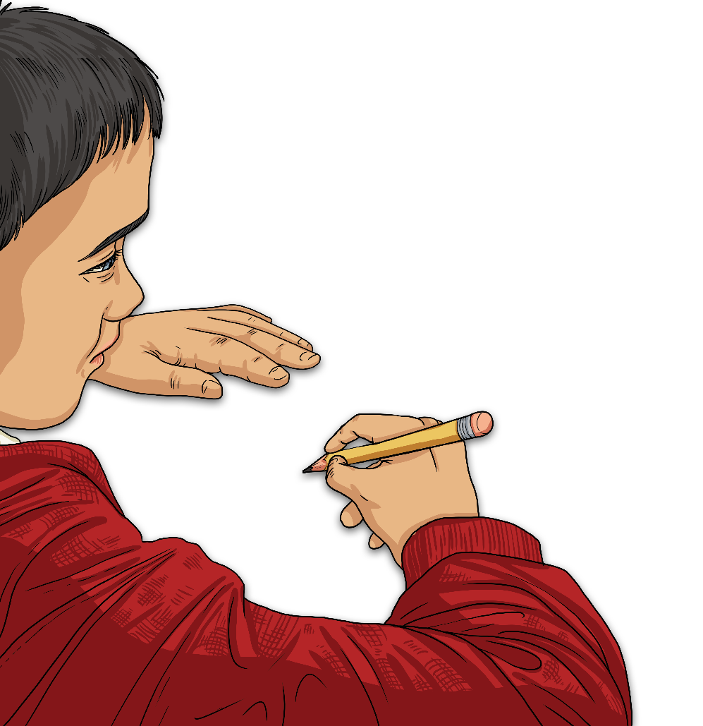
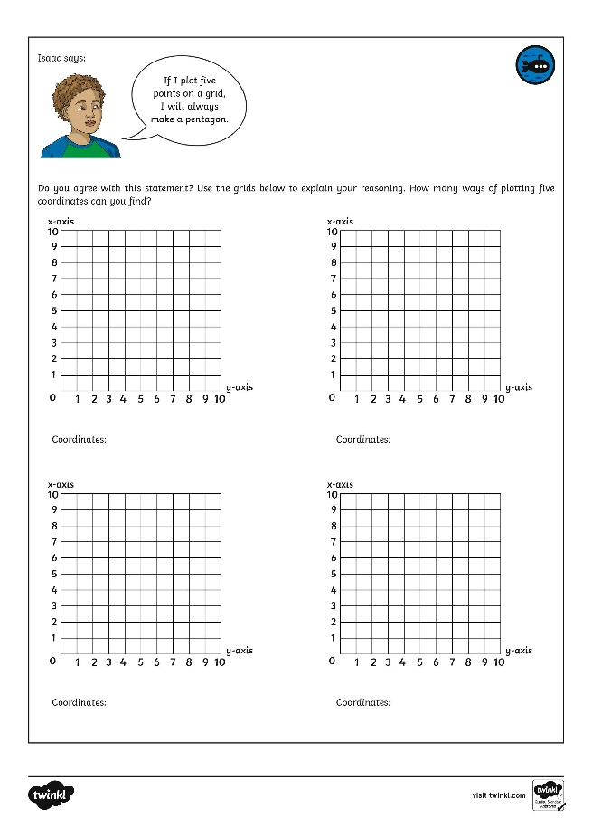
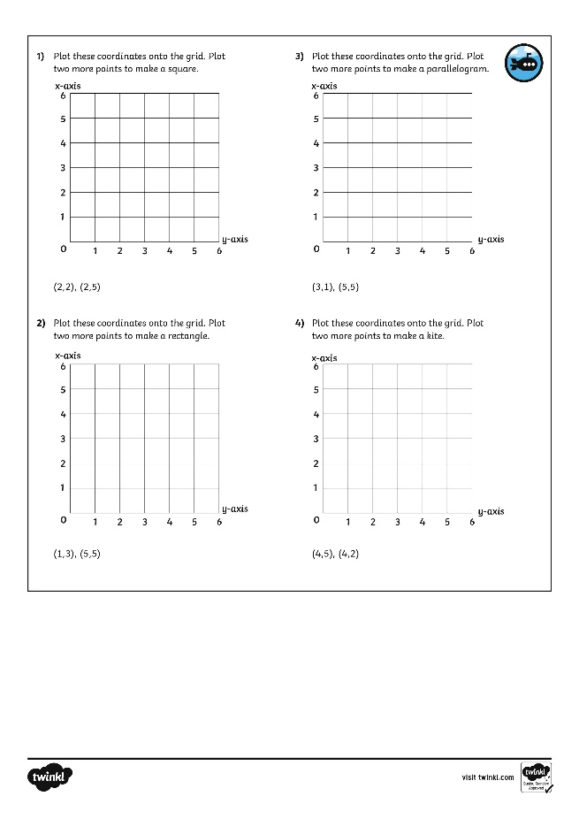
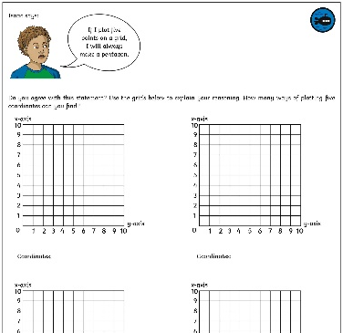
Draw on a Grid
Dive in by completing your own activity!

Slide 11
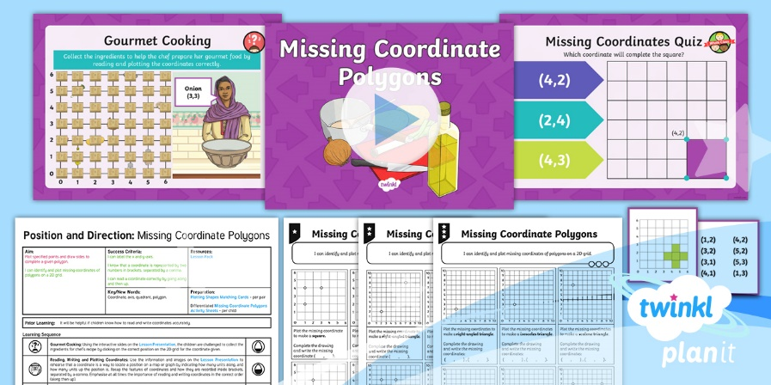
Need Planning to Complement this Resource?
National Curriculum Aim
Plot specified points and draw sides to complete a given polygon.
For more planning resources to support this aim, click here.
Twinkl PlanIt is our award-winning scheme of work with over 4000 resources.

